Slide 1
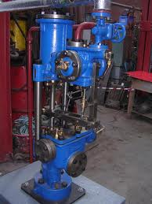
STUDY OF BOILER’S ACCESSORIES
BY KARAN VYAS

Slide 2
What is a boiler accessories?
Boiler’s accessories are these components which are installed either inside or outside the boiler to increase the efficiency of the plant and to help in the proper working of the plant.

Slide 3
Name of the boiler’s accessories
Air preheater
Economizer
Super-heater
Steam Separator
Steam Trap
Feed Pump

Slide 4
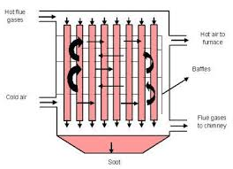
Air preheater
The function of air preheater is to increase the temperature of air before enters the furnace.
It is generally placed after the economizer so the flue gases on one side and air on other.
It preheats the to be supplied to the furnace.pre-heated air accelerates the combustion and facilitates the burning of coal.

Slide 5
WORKING OF AIR PREHEATER DEPEND ON:
Type of fuel
Type of fuel burning equipment
Rating at which boiler and furnace are operated

Slide 6
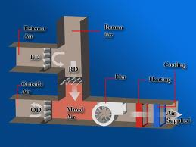
Economizer
It is a device in which the waste heat of the flue gases is utilized for heating the feed water.
To recover some of heat being carried over by exhaust gases.
This heat is used to raise the temperature of feed water supplied to the boiler.

Slide 7
Advantages of using Economizer
Evaporative capacity of boiler is increased.
Overall efficiency of the plant is increased.
If the boiler is fed with cold water it may results in chilling the boiler metal.
The temperature range between various parts of the boiler is reduced which results in reduction of stresses due to unequal expansion.

Slide 8
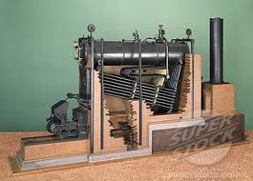
Super-heater
Super -heater is a device which increase the temperature of the steam above its saturation point.
The steam generated above the surface of water is always wet which causes erosion of turbine blades, pipes etc.
So that super heated air is required and therefore we use super-heater in boiler.

Slide 9
Advantages of super-heater
Erosion of turbine blade is eliminated.
Thermal efficiency of steam plant is increased.
Steam consumption is reduced.

Slide 10
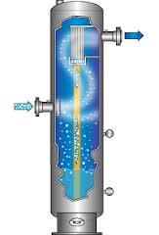
Steam separator
Steam separator removes the suspended water particles from the steam.
Steam is collected from a boiler may be wet,dry or super-heated, but many case steam become wet due to loss of heat during passing through steam pipe.
The use of wet steam in an engine or turbine is not economical .so there is need to separate the water particals from the steam.

Slide 11
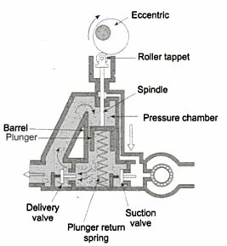
Feed pump
It is used to feed the water into the boiler under pressure through feed check valve.
It is a device of boiler used to supplied proper amount of water at least equal to that evaporated in the boiler.

Slide 12
Classification of Feed Pump
Reciprocating Pumps
Rotary Pump
Centrifugal Pump

Slide 13
Thank You

